Slide 1





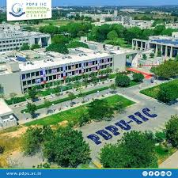
GSC, VADNAGAR
SSIP2.0
KCG
One Day Exposure cum Field Trip of
Students to Innovation and Incubation Center, PDEU, Gandhinagar
Coordinator: Dr Neha A. Nandkeolyar
Principal: Dr P. S. Patel
Date : 04 February 2026 Reporting Time: 07:30 am at GSC, VADNAGAR
Bus will leave the campus by 8:00 AM and return back by 5:00 pm

